Slide 1

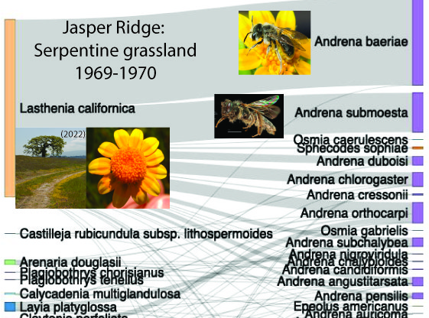
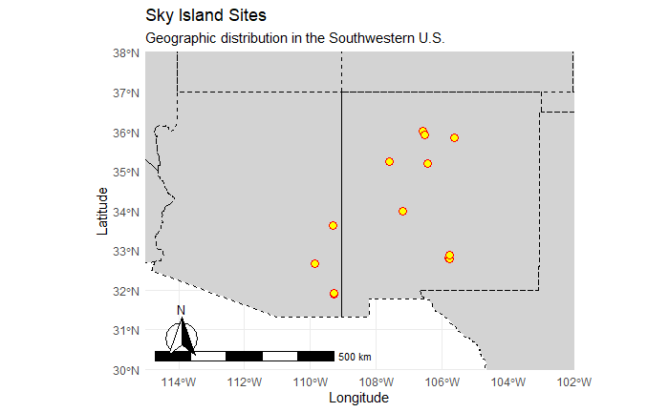
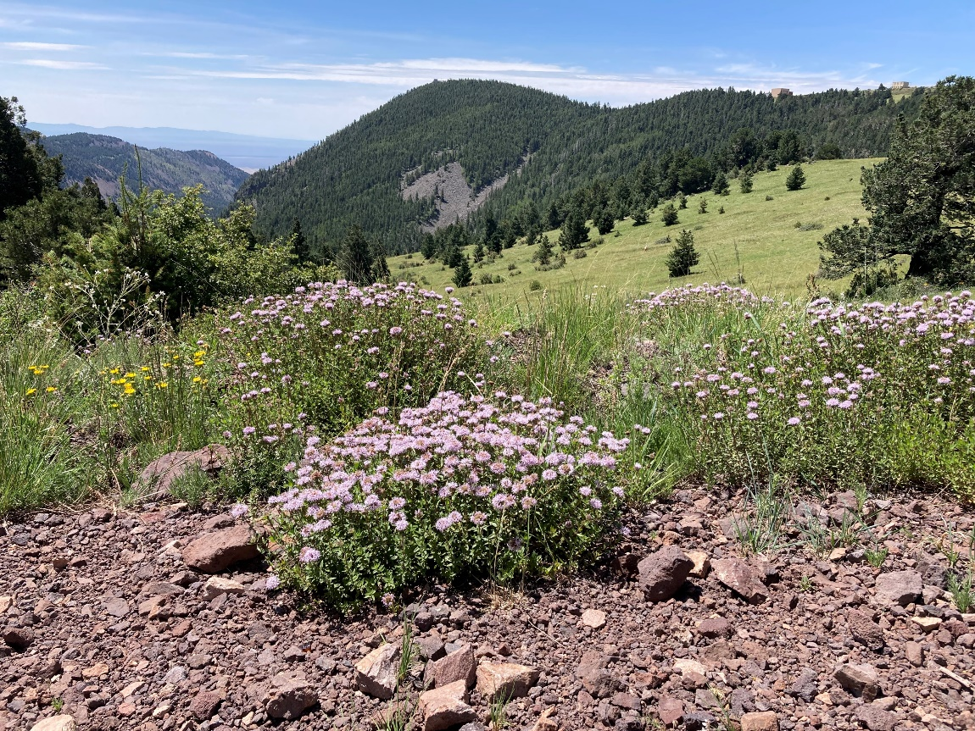
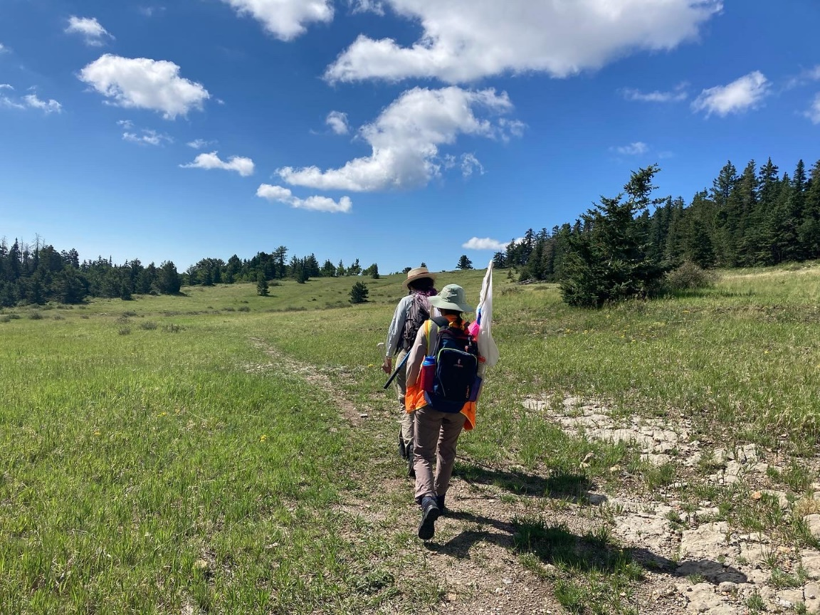
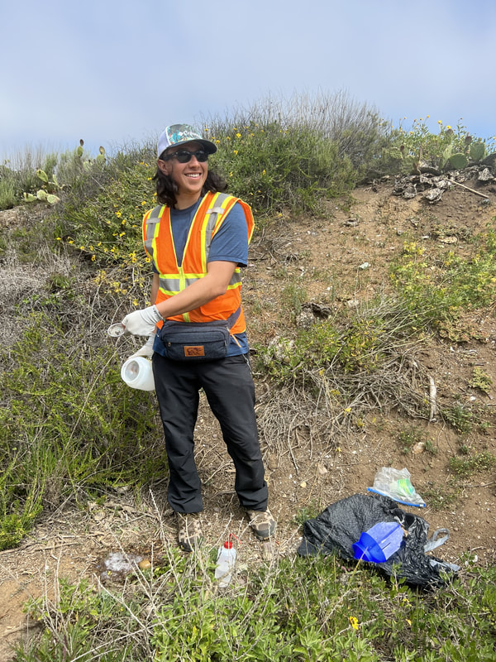
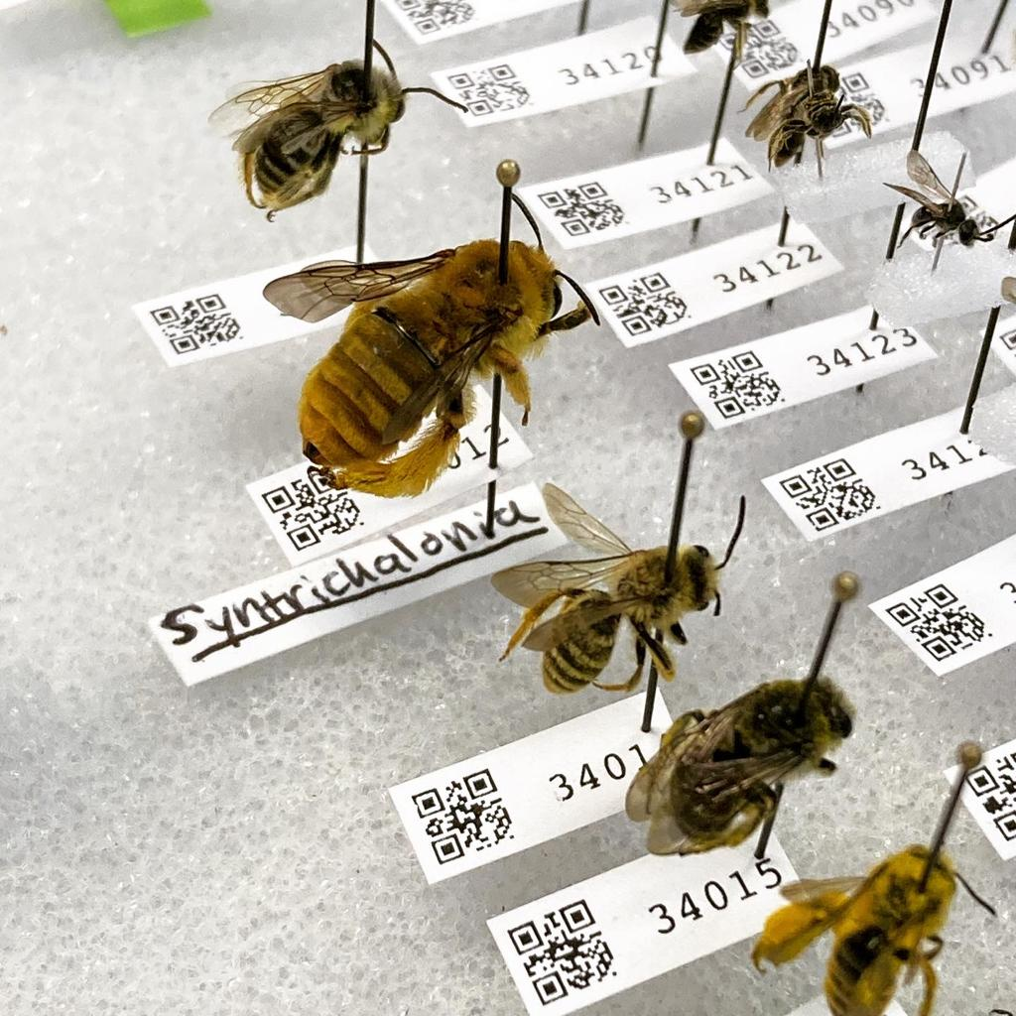
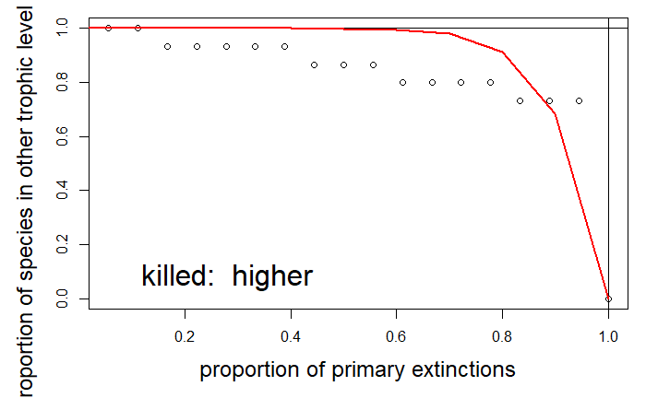
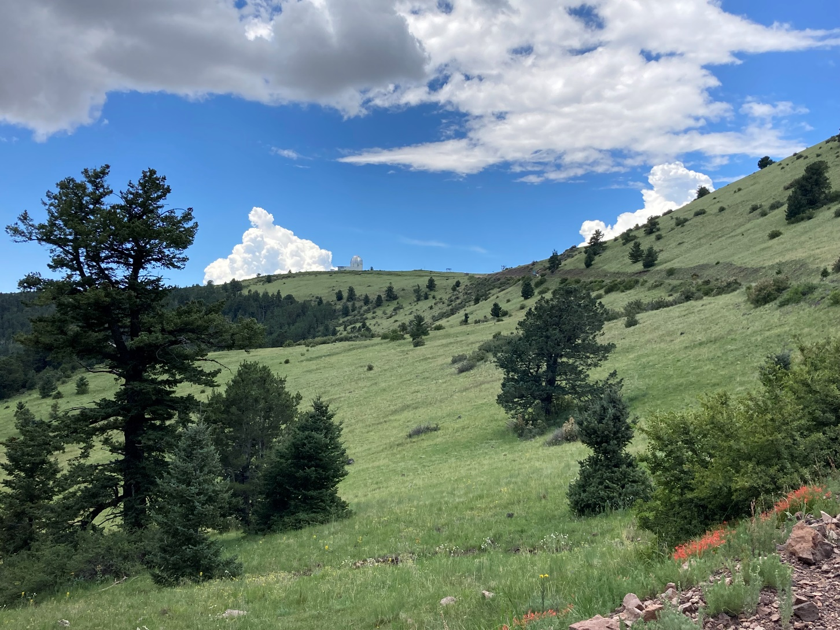
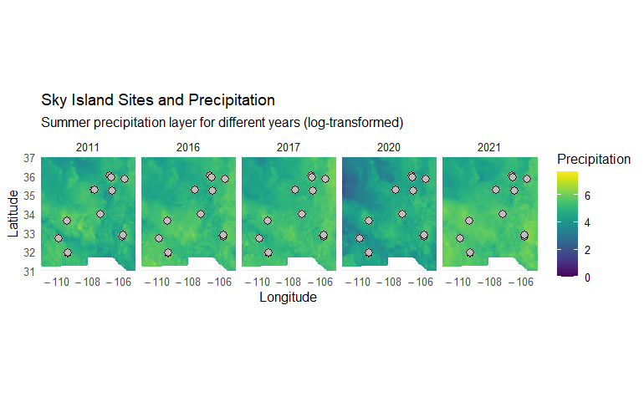
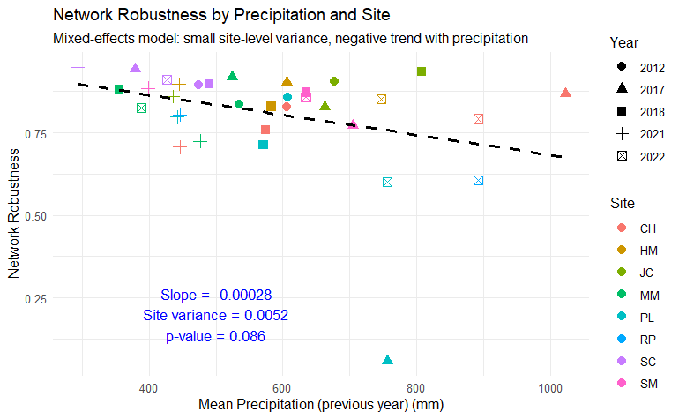
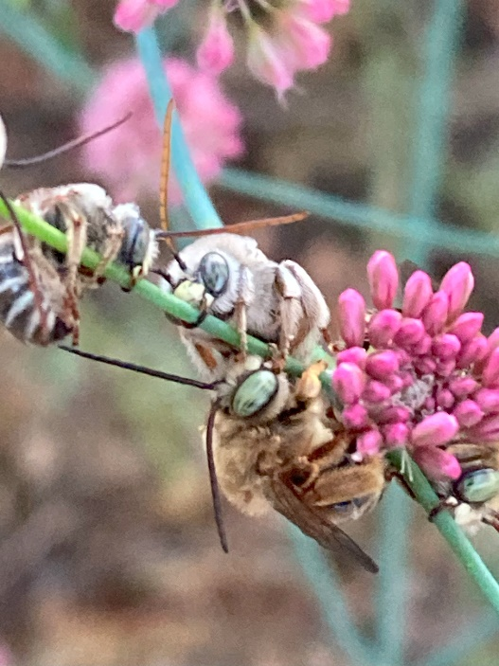
Linking Summer Precipitation to Pollination Network Robustness in Sky Island Ecosystems
Alejandro Santillana
University of Oregon, Department of Biology
Introduction
Study System
Conclusions
Mutualisms, like plant-pollinator interactions, are weakened by human-driven disruptions to ecological networks (Urban 2015; Memmott et al. 2007). Disruptions increase the risk of extinction cascades where the loss of one species triggers declines in others (Memmott et al. 2004).
Quantifying community robustness—defined as the ability of networks to resist species loss—is critical for understanding ecosystem stability (Dunne et al. 2002).
1. Robustness and Precipitation: There is a slight negative trend between the summer precipitation in the previous year and the robustness of the plant-pollinator networks in the study sites. This suggests that higher precipitation may contribute to lower network robustness, although the trend is weak and not statistically significant (p-value = 0.086).
2. Site-Level Variance: The linear mixed-effects model reveals that there is minimal variance at the site level, implying that the observed trends in robustness are not strongly influenced by specific sites. The model indicates a very small site-level variance component (0.0052), suggesting that precipitation impacts network robustness relatively uniformly across the study sites.
3. Secondary Extinctions and Network Stability: Using the second extinction method to simulate the removal of species from the pollination webs revealed that the stability of the networks, as measured by secondary extinctions, is influenced by the abundance of species in the network. The robustness calculations, informed by these secondary extinctions, indicate a need for understanding how species loss cascades through the network.
4. Spatial and Temporal Variability: By merging precipitation data with network robustness results, this study highlights temporal and spatial variability in network robustness and its potential relationship with climatic factors, such as precipitation. This opens avenues for understanding how climate variability might drive changes in ecosystem stability over time.
In summary, while there is some evidence for a negative relationship between precipitation and network robustness, this relationship is not strongly significant across sites. Further research with more extensive data and possibly additional environmental variables could help clarify these trends.
Gap: While many studies focus on the effects of climate change on individual species or biodiversity patterns, few have investigated how precipitation directly impacts plant-pollinator network vulnerability to extinction cascades.
Research Question
How does previous summer precipitation influence the robustness of pollination networks across Sky Island sites, and does this relationship vary over time or between sites?
This question examines:
Network Robustness
Precipitation as an Environmental Factor
Temporal and Spatial Variation
Role of Site-Level Effects
Methods and Results
proportion of plant species remaining
Methods
Specimen collection
Specimen curation
Network Robustness Simulation
Primary extinctions (pollinator removal) were simulated based on species abundance, measuring secondary extinctions (plants dependent on extinct pollinators).
Calculated robustness as the area under the extinction curve.
Environmental Data Acquisition
Downloaded summer precipitation data from PRISM.
Precipitation rasters were summed across June–September for each year to generate annual summer precipitation totals.
Spatial Analysis and Data Extraction
Imported site shapefiles, projected them to match precipitation raster coordinate systems, and extracted precipitation data at each study site for the respective years.
Data Integration
Aligned precipitation data with robustness results, offsetting precipitation year by +1 to reflect the lag effect of precipitation on pollination networks.
Statistical Analysis and Visualization
Fit a linear mixed-effects model to evaluate the effect of mean precipitation and year on network robustness, accounting for random effects of sites.
Visualized relationships between robustness, precipitation, and site-specific patterns, highlighting trends and site-level variance.
References
Urban, M. C. Accelerating extinction risk from climate change. Science 348, 571–573 (2015).
Memmott, J., Craze, P. G., Waser, N. M. & Price, M. V. Global warming and the disruption of plant–pollinator interactions. Ecology Letters 10, 710–717 (2007).
Memmott, J., Waser, N. M. & Price, M. V. Tolerance of Pollination Networks to Species Extinctions. Proceedings: Biological Sciences 271, 2605–2611 (2004).
Dunne, J. A., Williams, R. J. & Martinez, N. D. Network structure and biodiversity loss in food webs: robustness increases with connectance. Ecology Letters 5, 558–567 (2002).
Acknowledgments
Bi510: Data science for the environment.
Dr. Lauren Ponisio
Ponisio Lab, University of Oregon
Jha Lab, The University of Texas at Austin
Institute of Ecology and Evolution, University of Oregon
Department of Biology, University of Oregon PRISM (PRISM Climate Group, Oregon State University, https://prism.oregonstate.edu, data created 4 Feb 2014, accessed 4 Dec 2024.)

